Slide 1
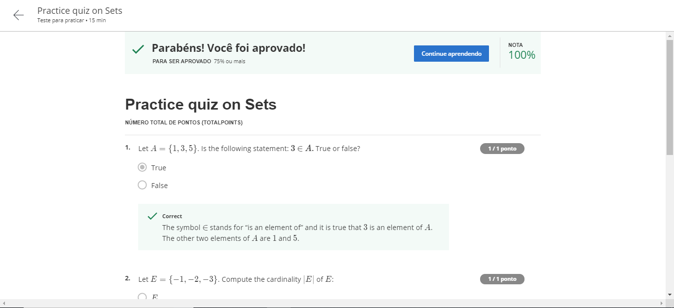
Sets and what they are good for

Slide 2
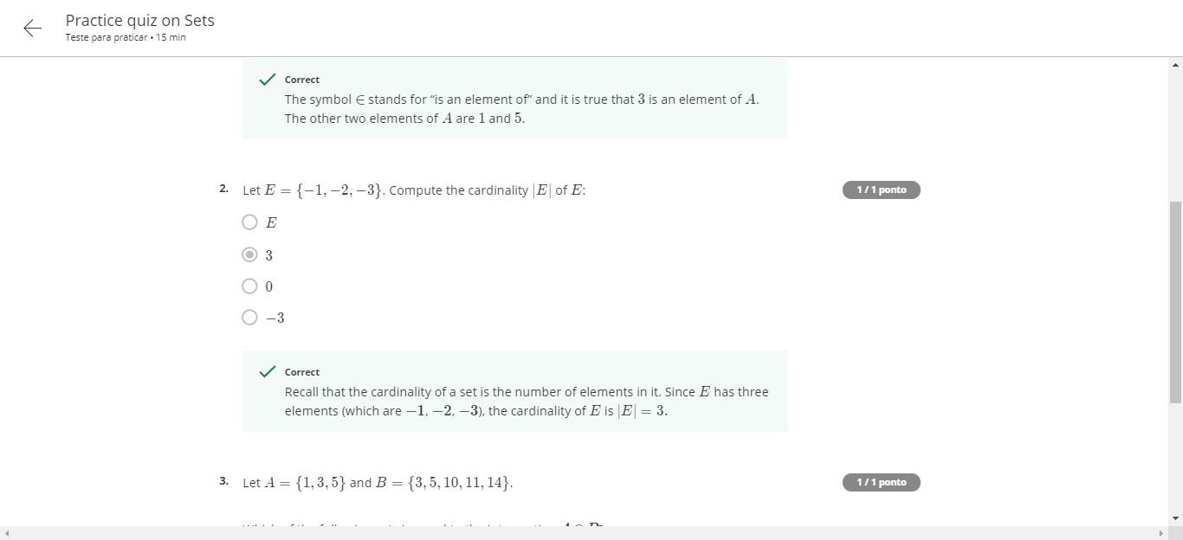
Sets and what they are good for

Slide 3
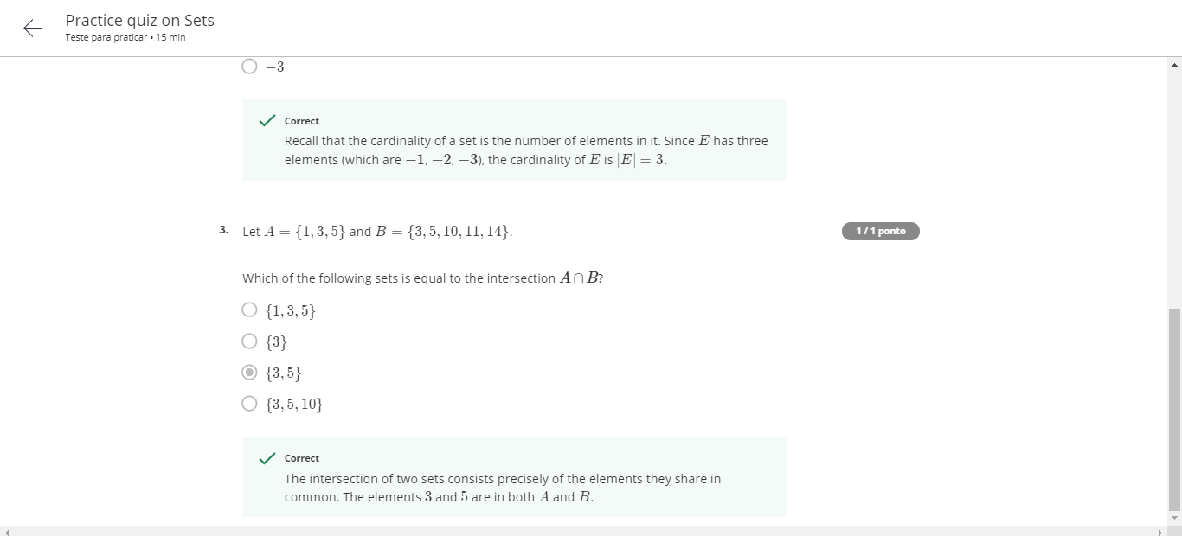
Sets and what they are good for

Slide 4
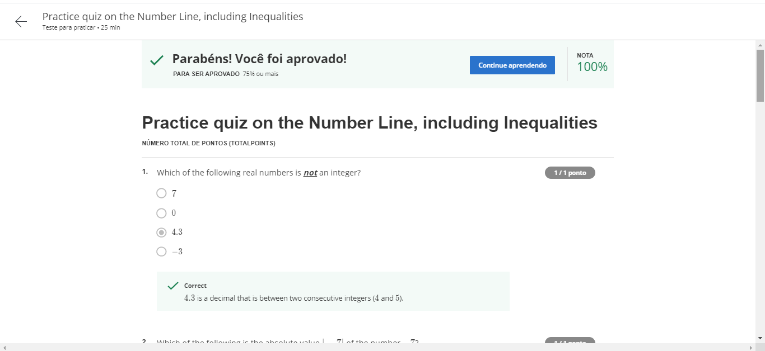
Infinite world of real numbers

Slide 5
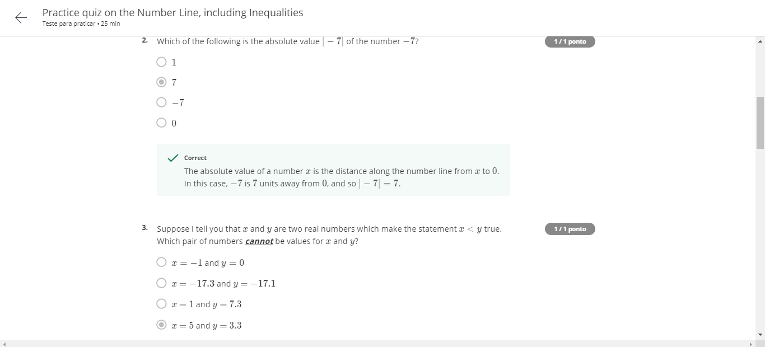
Infinite world of real numbers

Slide 6
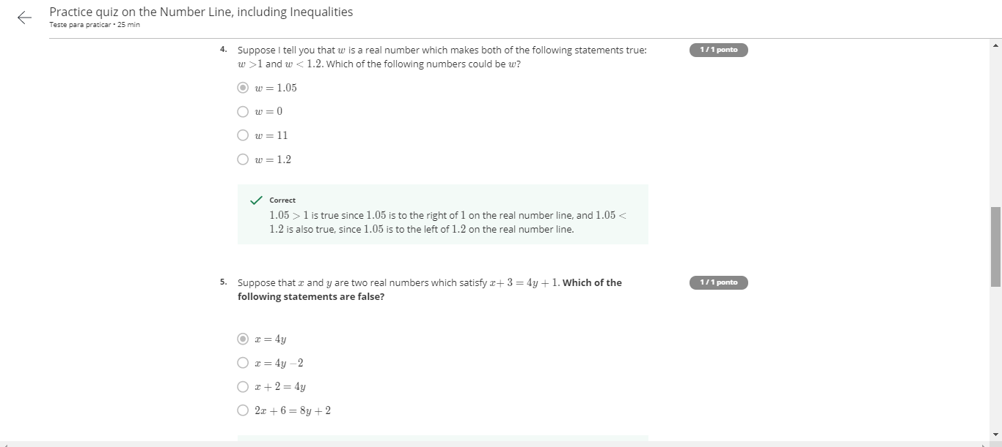
Infinite world of real numbers

Slide 7
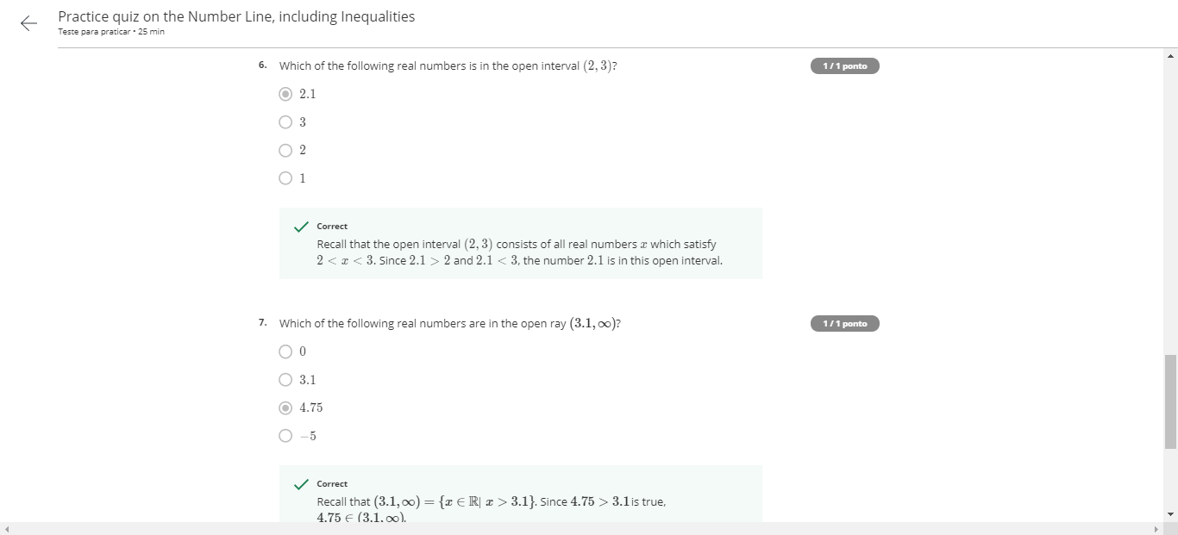
Infinite world of real numbers

Slide 8
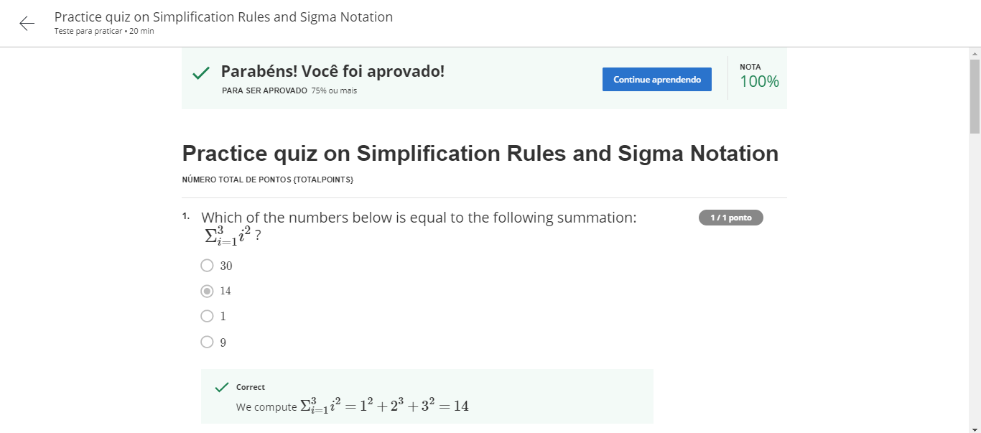
That jagged S symbol –practice exercises

Slide 9
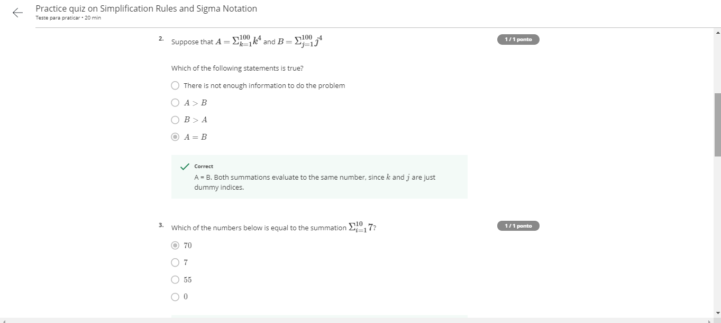
That jagged S symbol –practice exercises

Slide 10
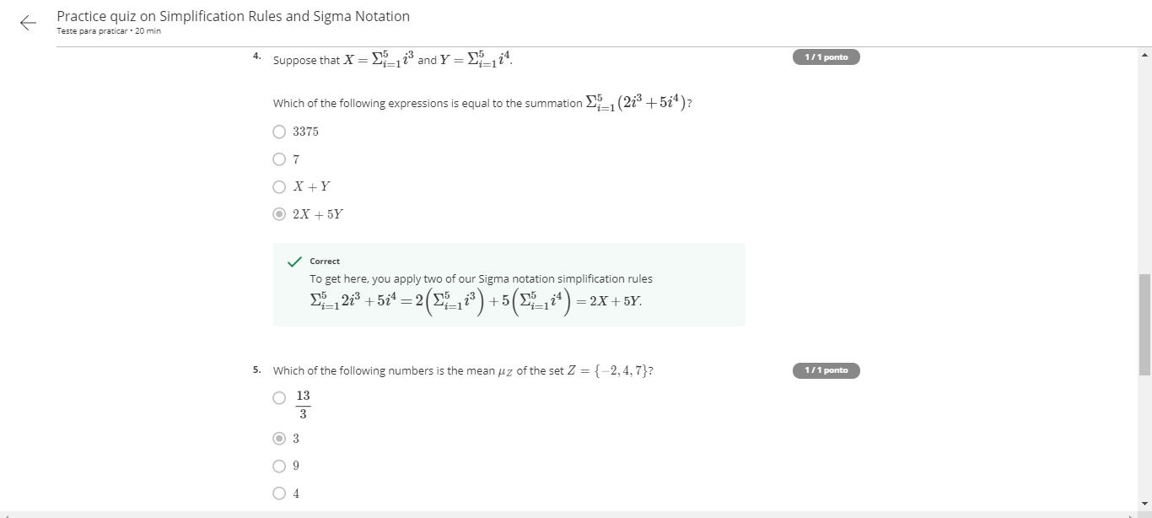
That jagged S symbol –practice exercises

Slide 11
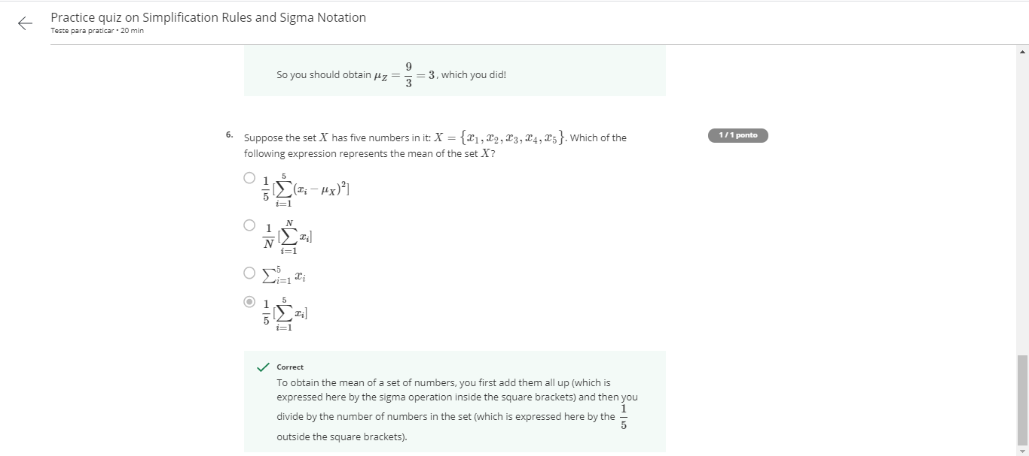
That jagged S symbol –practice exercises

Slide 12
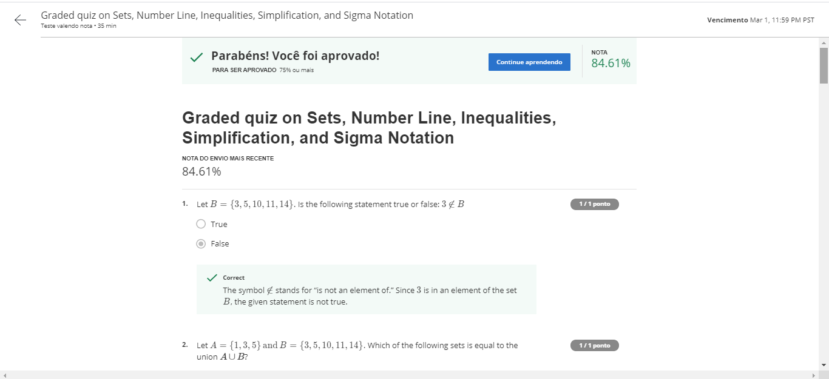
Graded Quiz

Slide 13
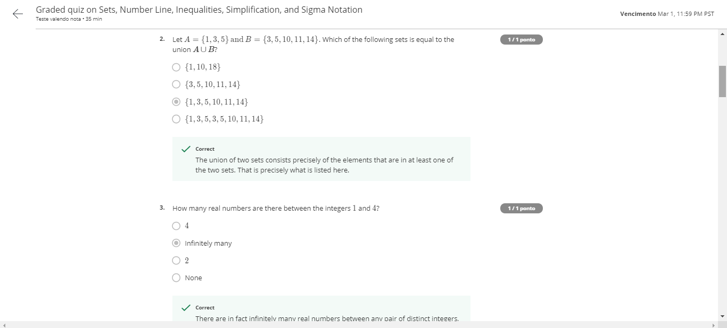
Graded Quiz

Slide 14
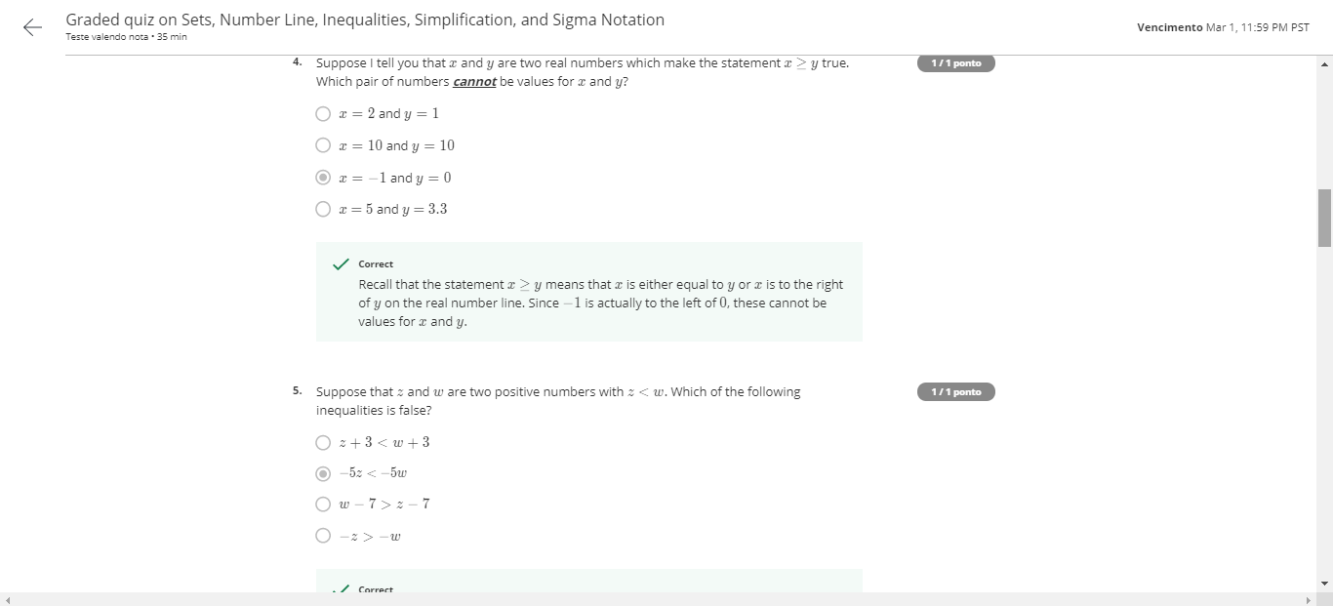
Graded Quiz

Slide 15
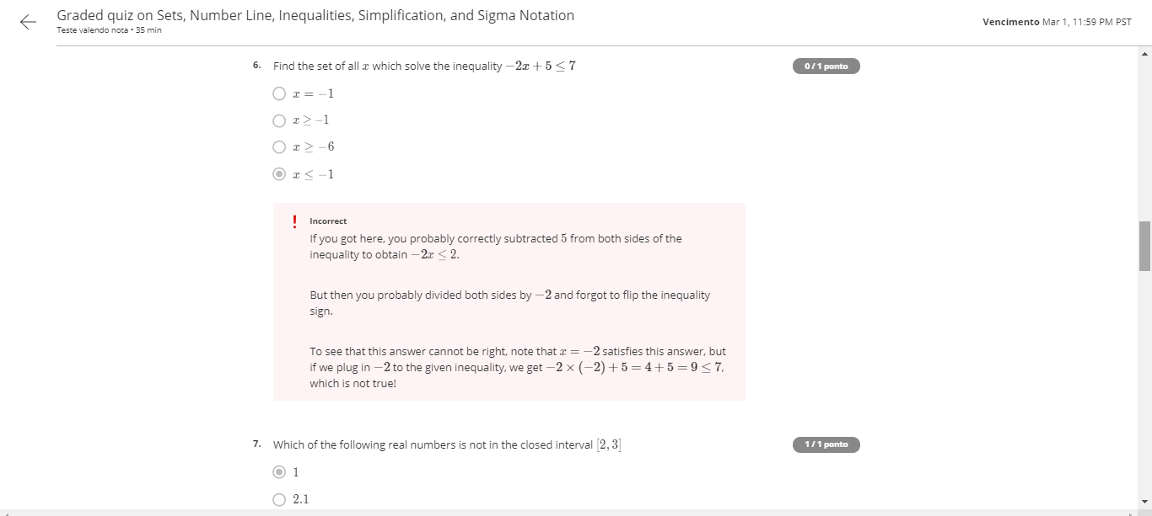
Graded Quiz

Slide 16
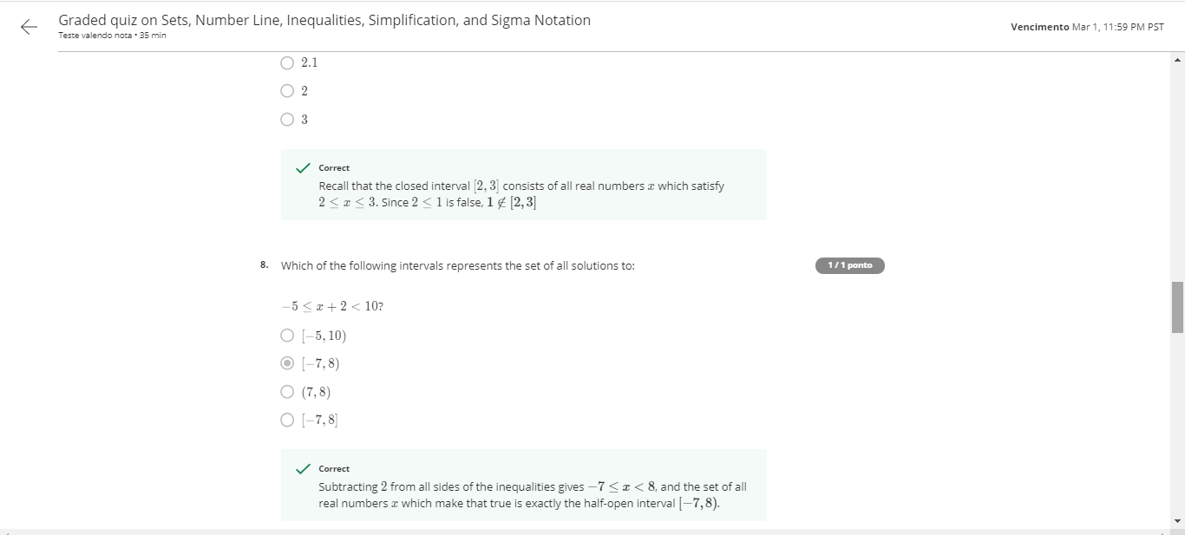
Graded Quiz

Slide 17

Graded Quiz

Slide 18
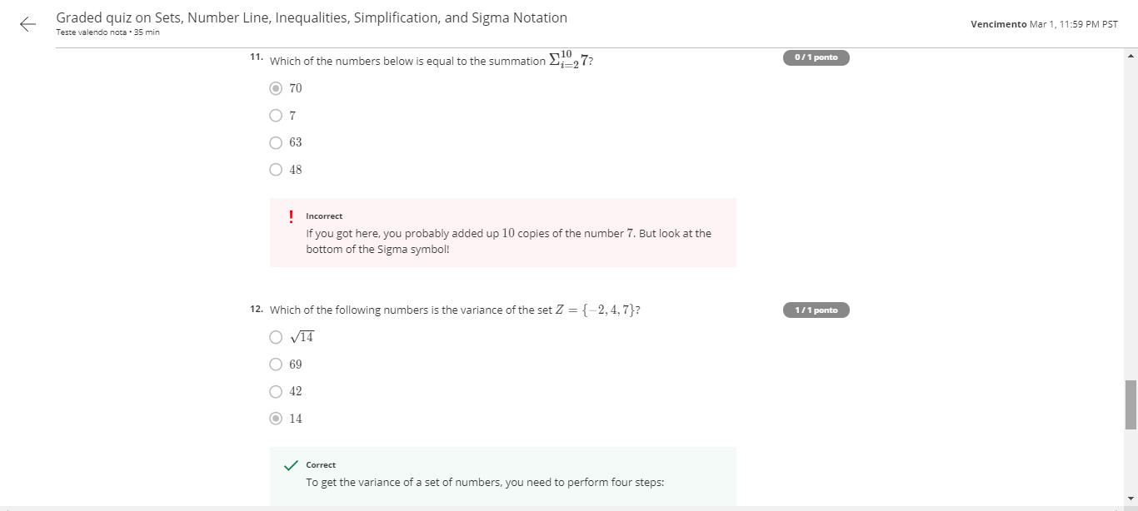
Graded Quiz

Slide 19
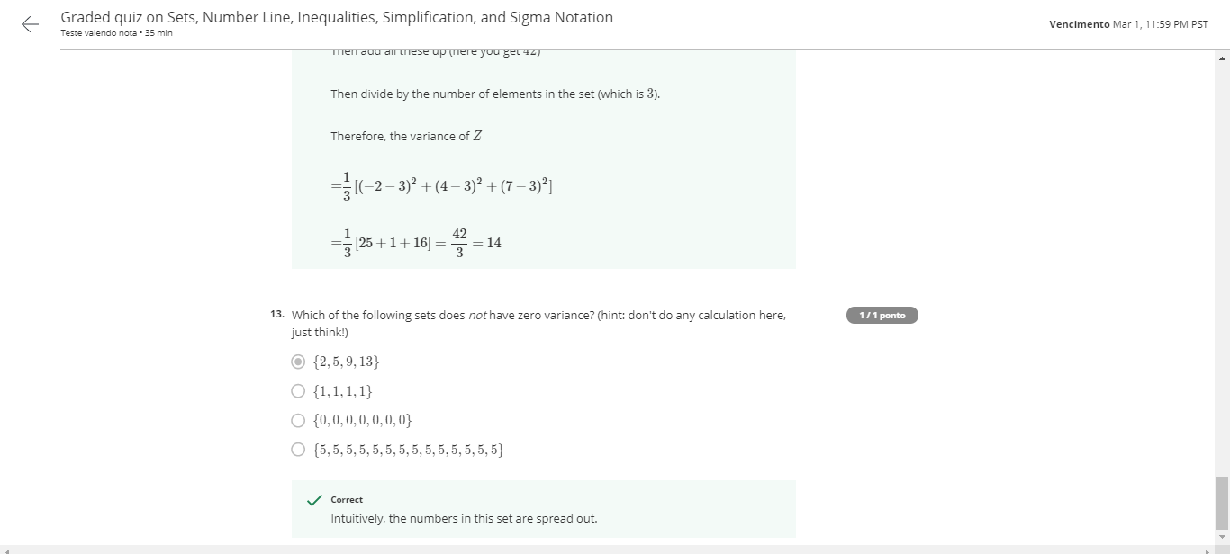
Graded Quiz

Slide 20
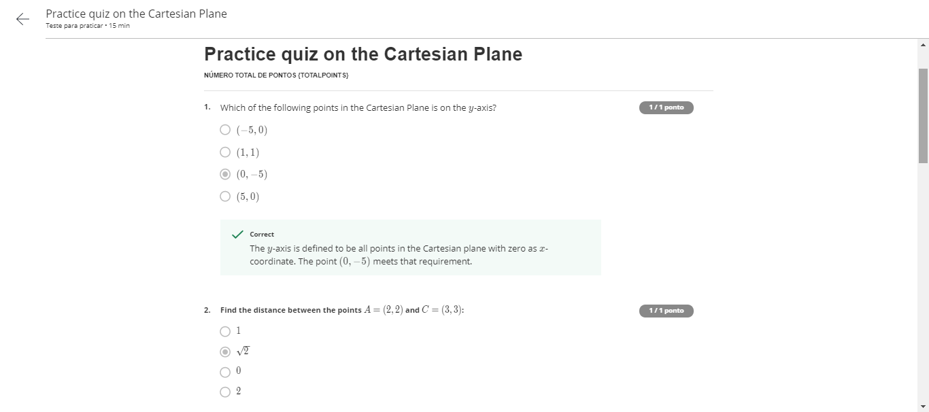
Descartes was really smart

Slide 21
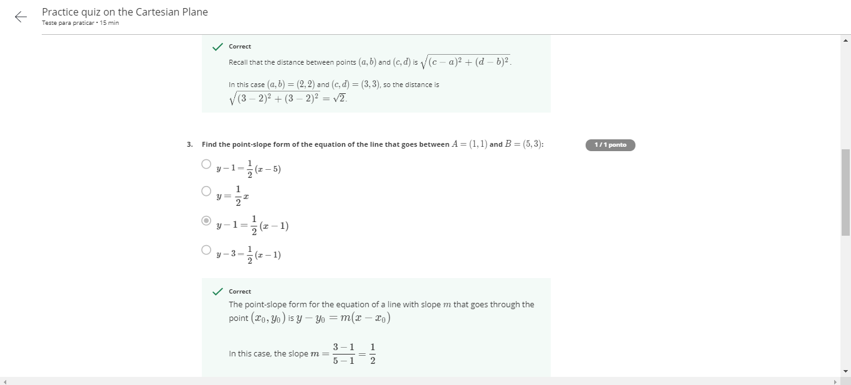
Descartes was really smart

Slide 22
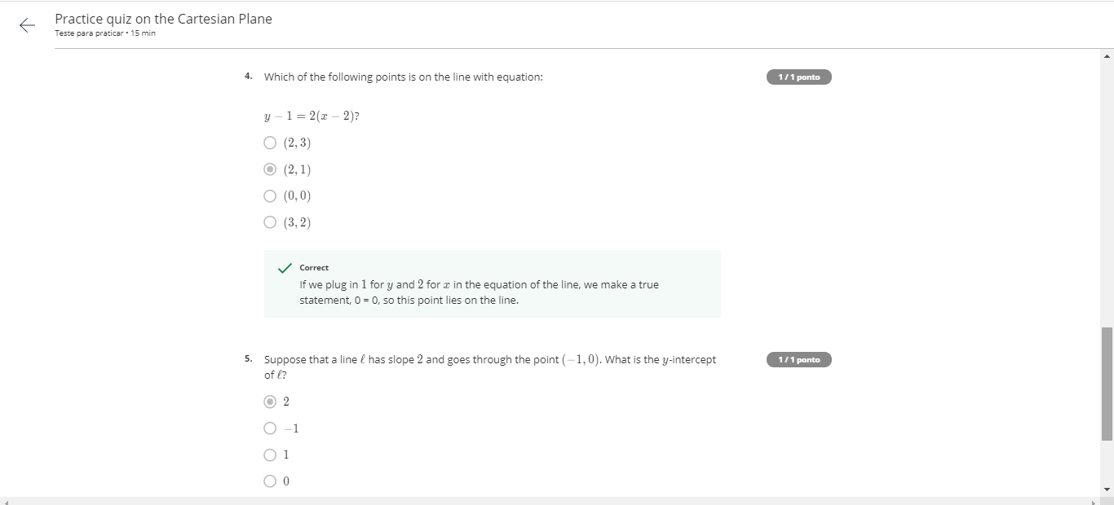
Descartes was really smart

Slide 23
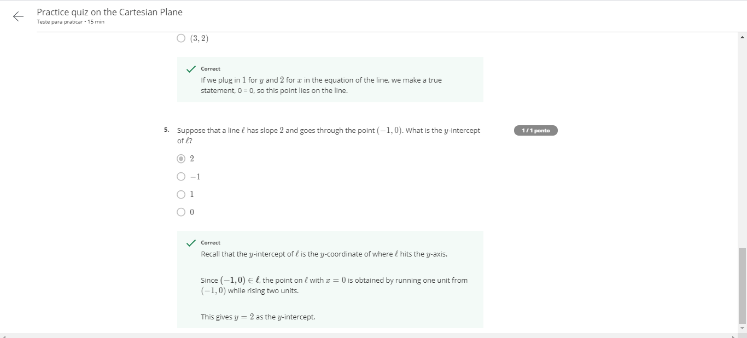
Descartes was really smart

Slide 24
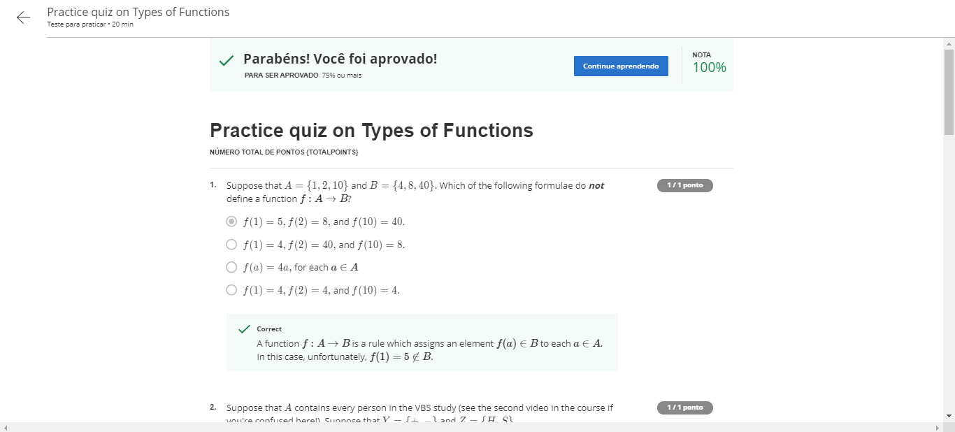
Types of functions

Slide 25
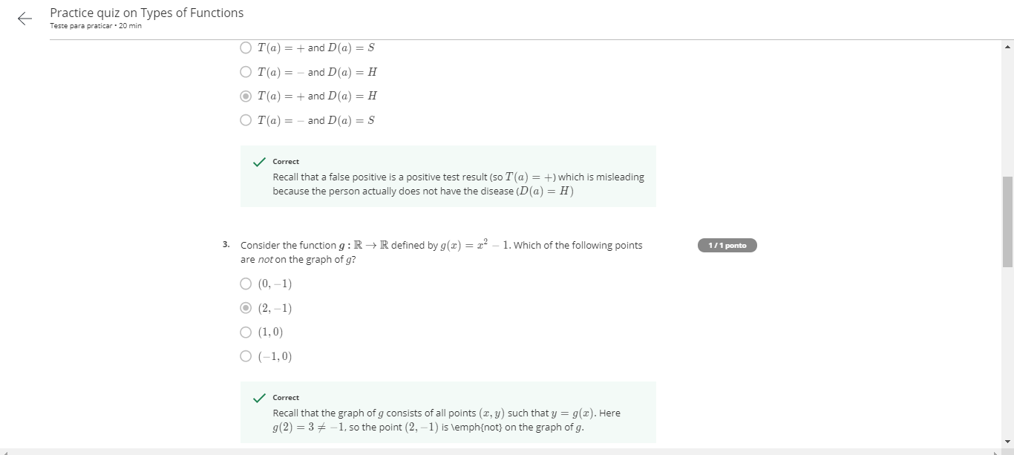
Types of functions

Slide 26
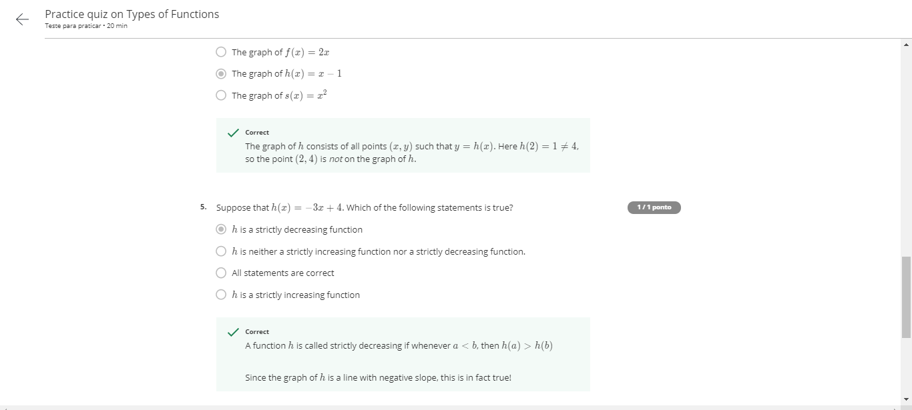
Types of functions

Slide 27
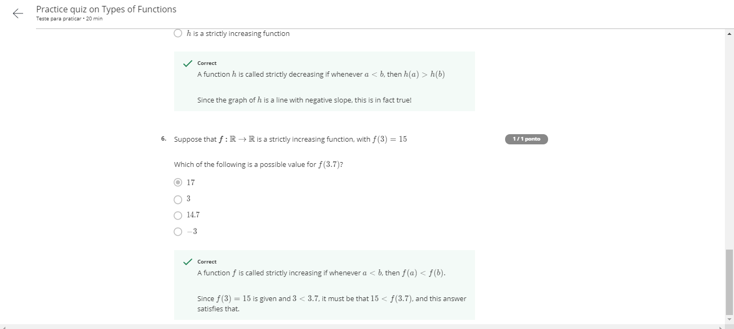
Types of functions

Slide 28
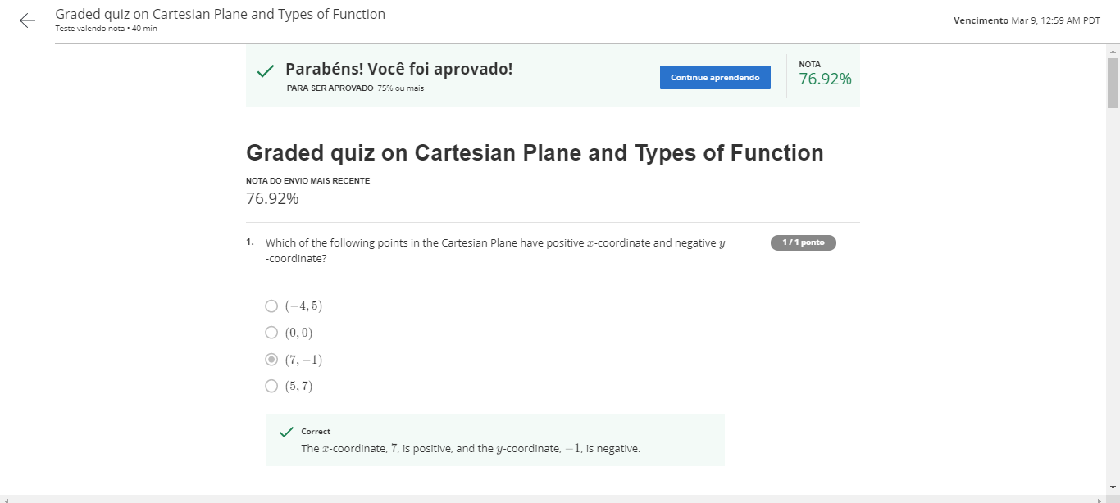
Cartesian plan and types of functions

Slide 29
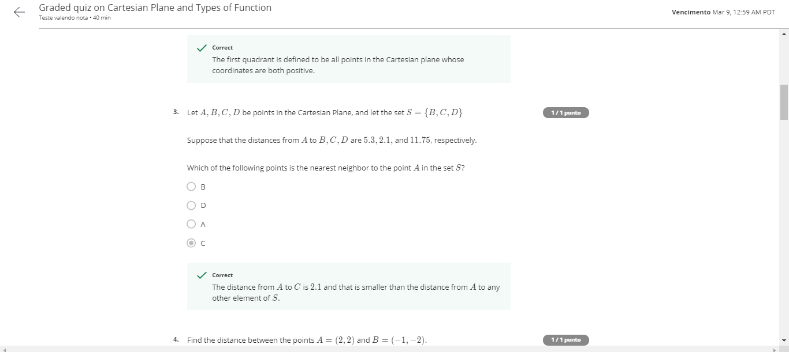
Cartesian plan and types of functions

Slide 30
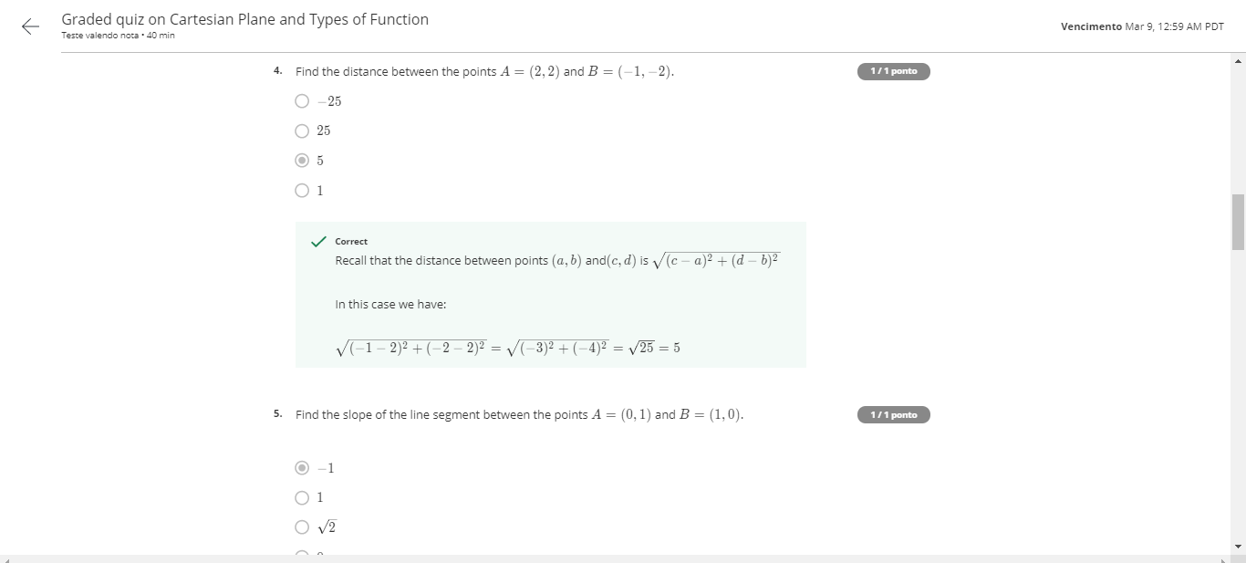
Cartesian plan and types of functions

Slide 31
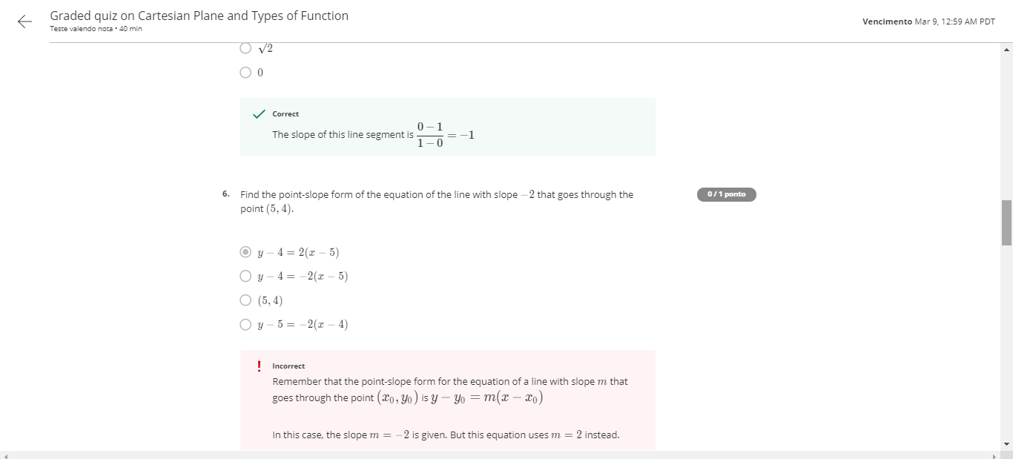
Cartesian plan and types of functions

Slide 32
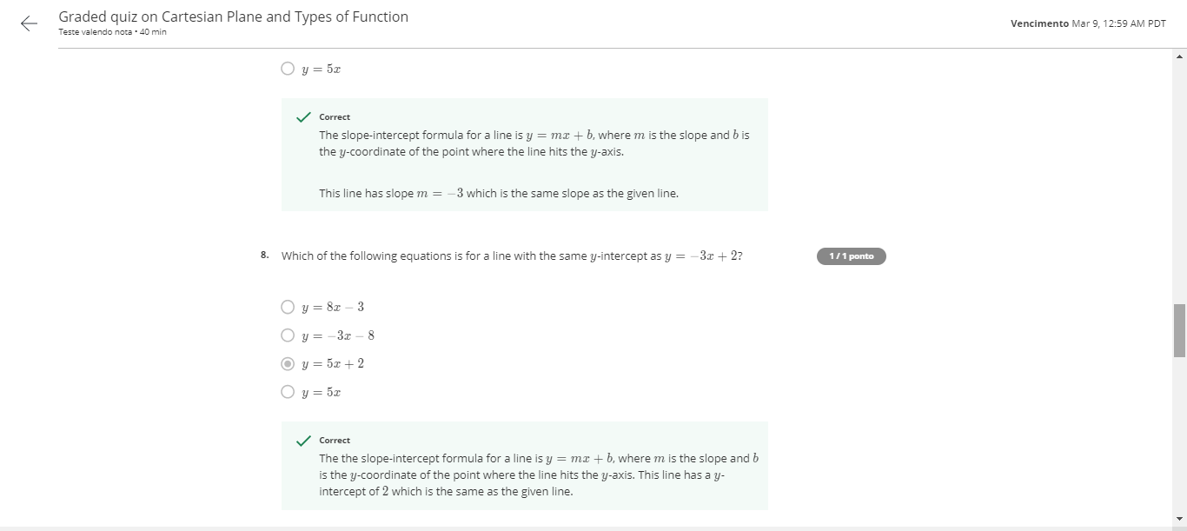
Cartesian plan and types of functions

Slide 33
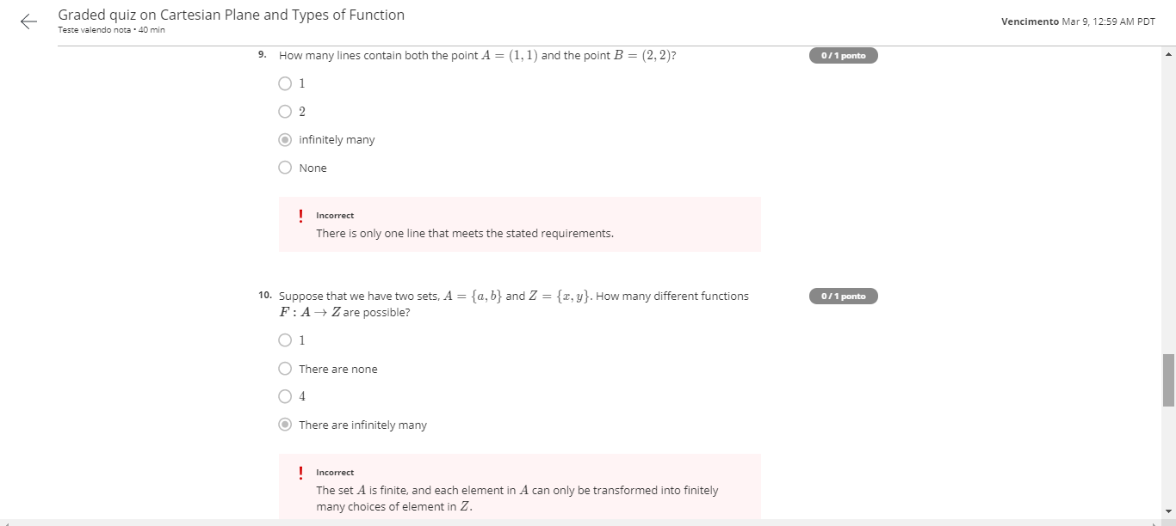
Cartesian plan and types of functions

Slide 34
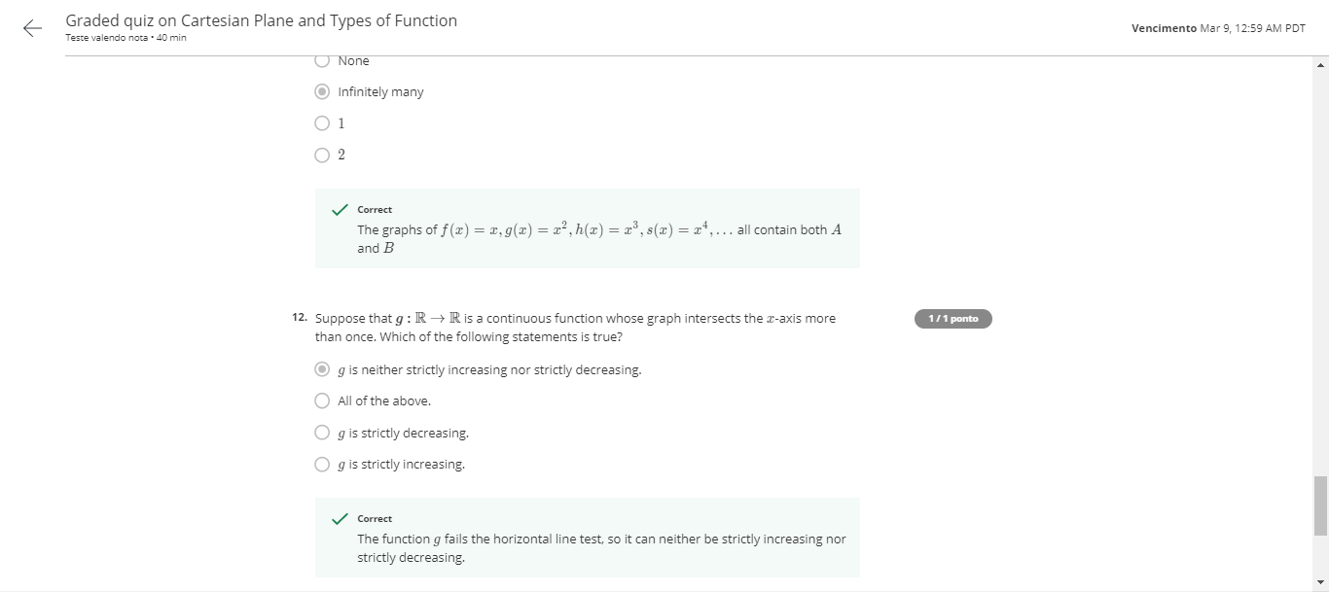
Cartesian plan and types of functions

Slide 35
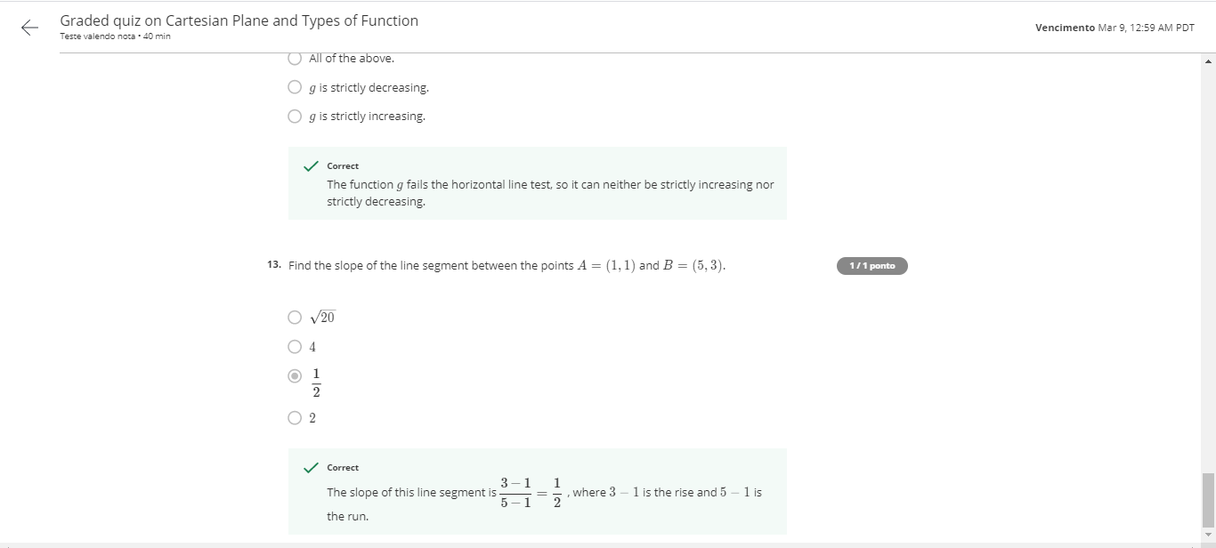
Cartesian plan and types of functions

Slide 36
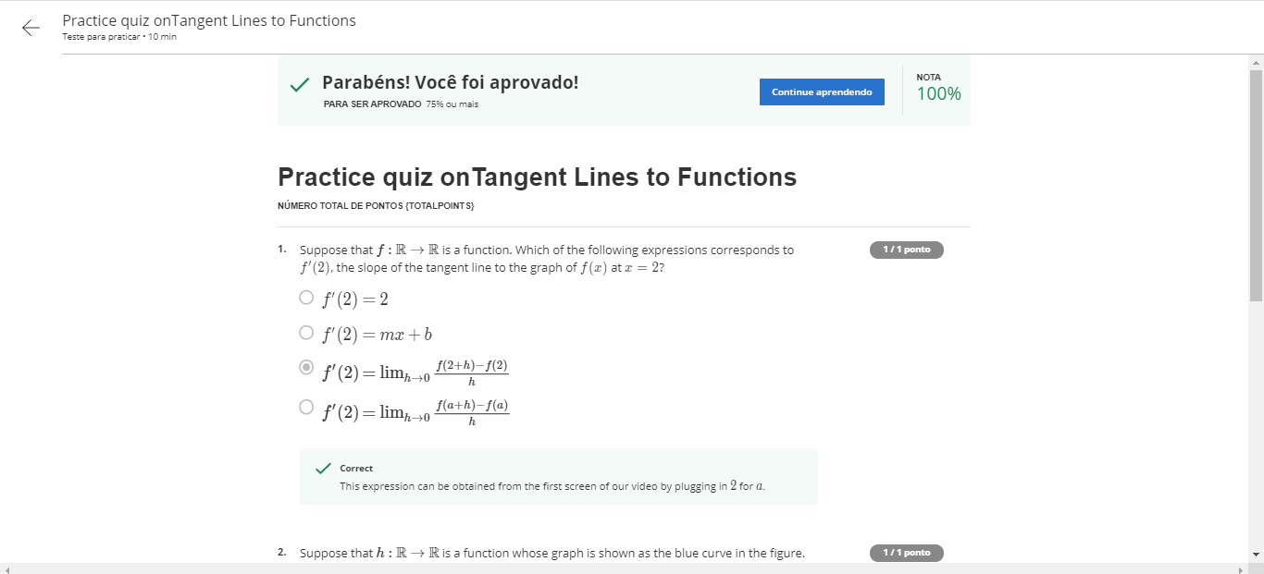
This is about that derivative stuff

Slide 37
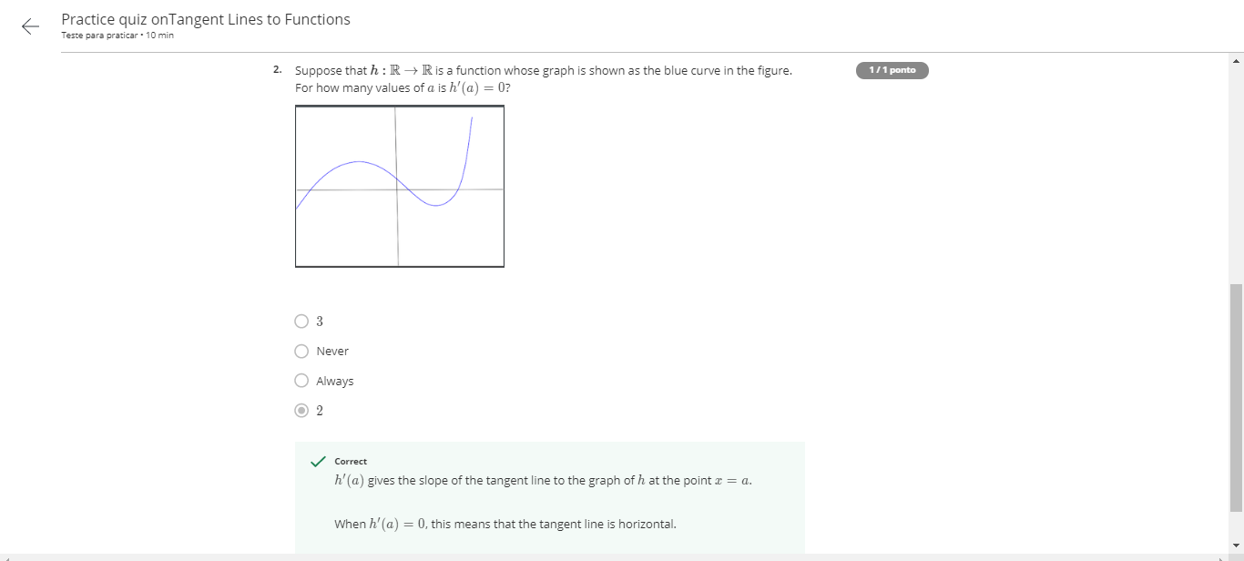
This is about that derivative stuff

Slide 38
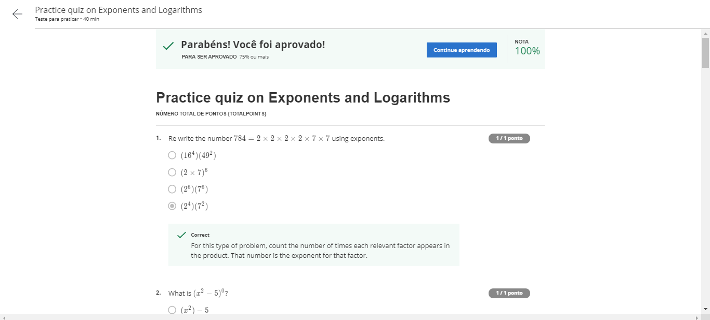
Practice Quizz on exponentes and log

Slide 39
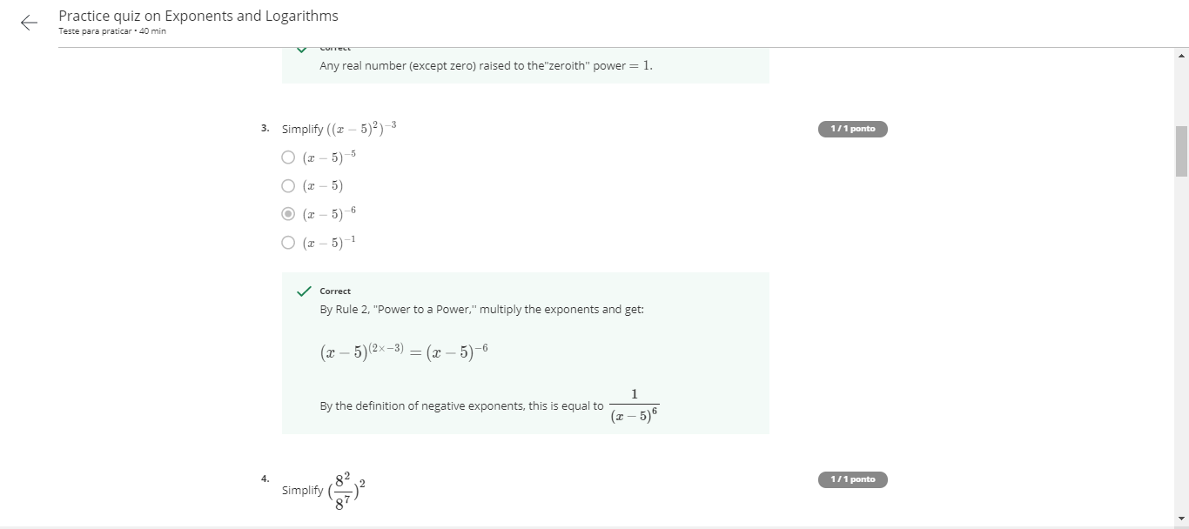
Practice Quizz on exponents and log

Slide 40
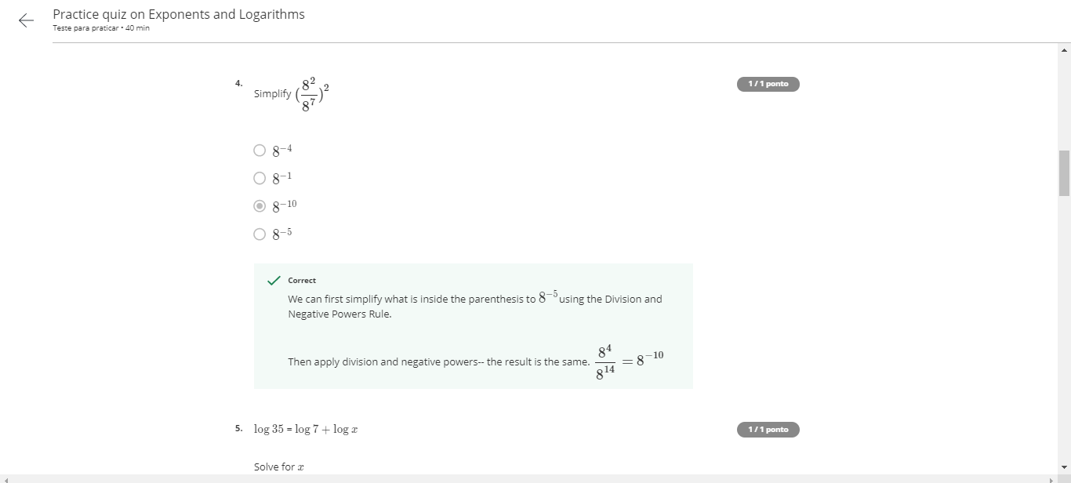
Practice Quizz on exponents and log

Slide 41

Practice Quizz on exponents and log

Slide 42
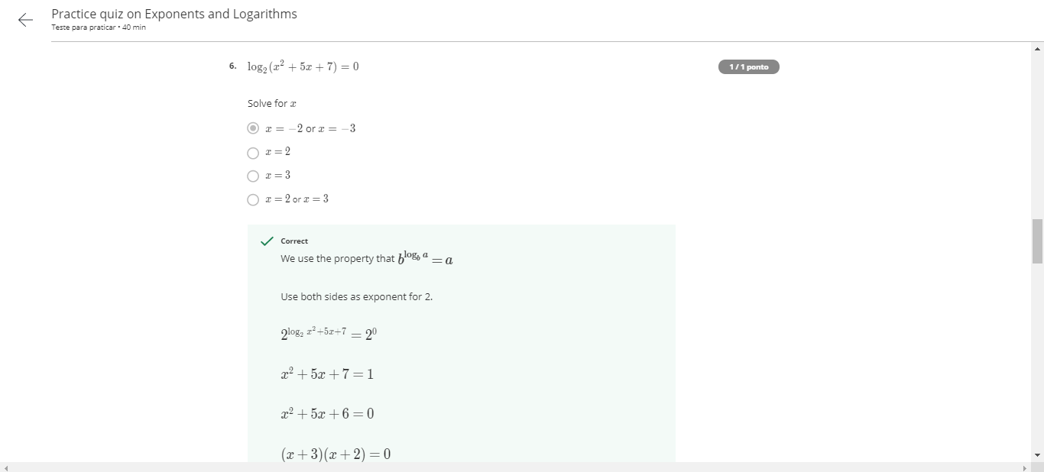
Practice Quizz on exponents and log

Slide 43
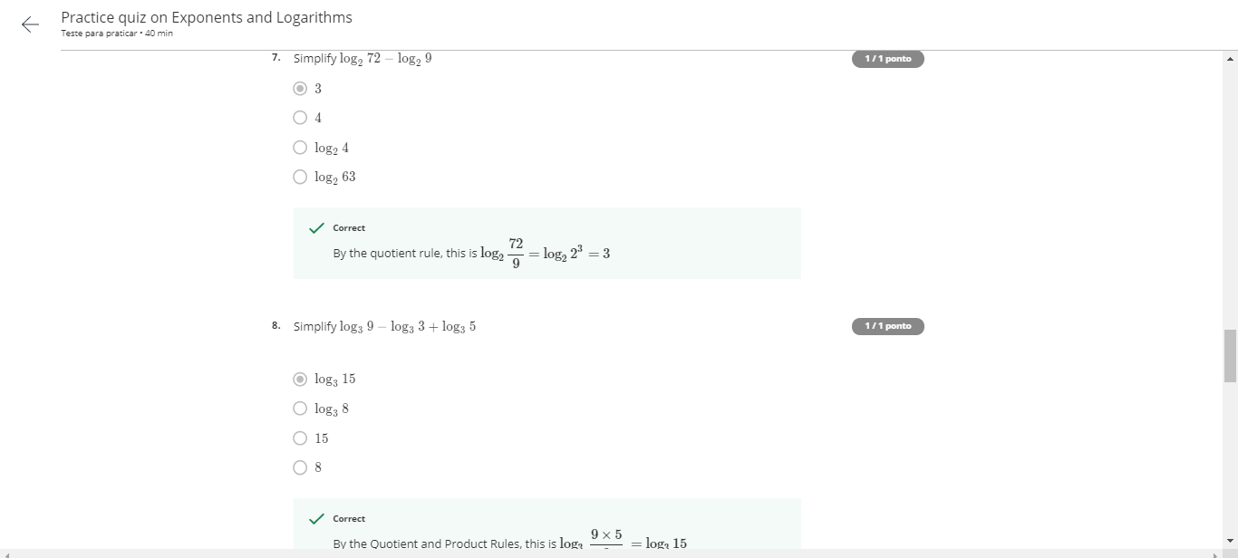
Practice Quizz on exponents and log

Slide 44
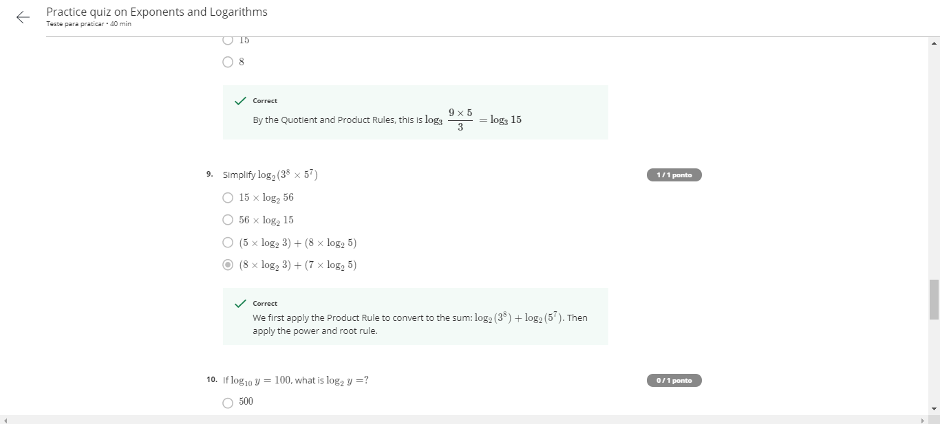
Practice Quizz on exponents and log

Slide 45

Practice Quizz on exponents and log

Slide 46
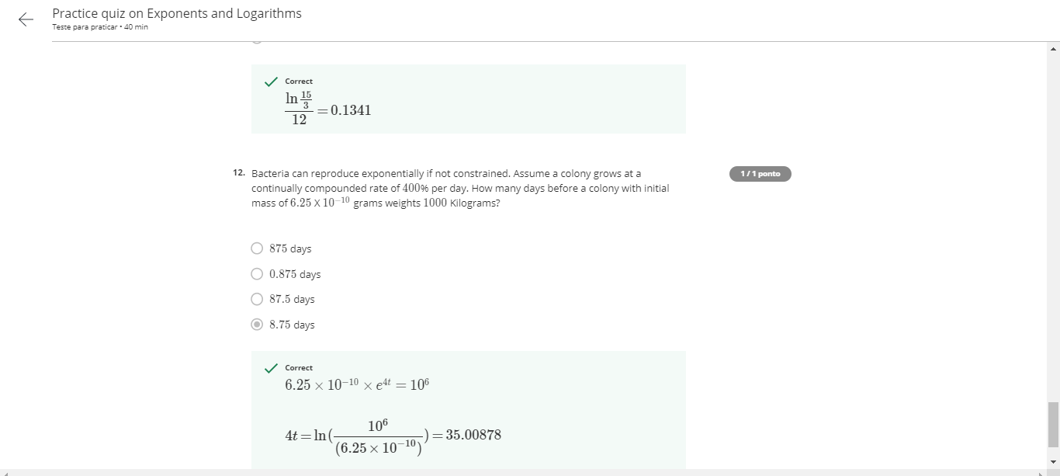
Practice Quizz on exponents and log

Slide 47
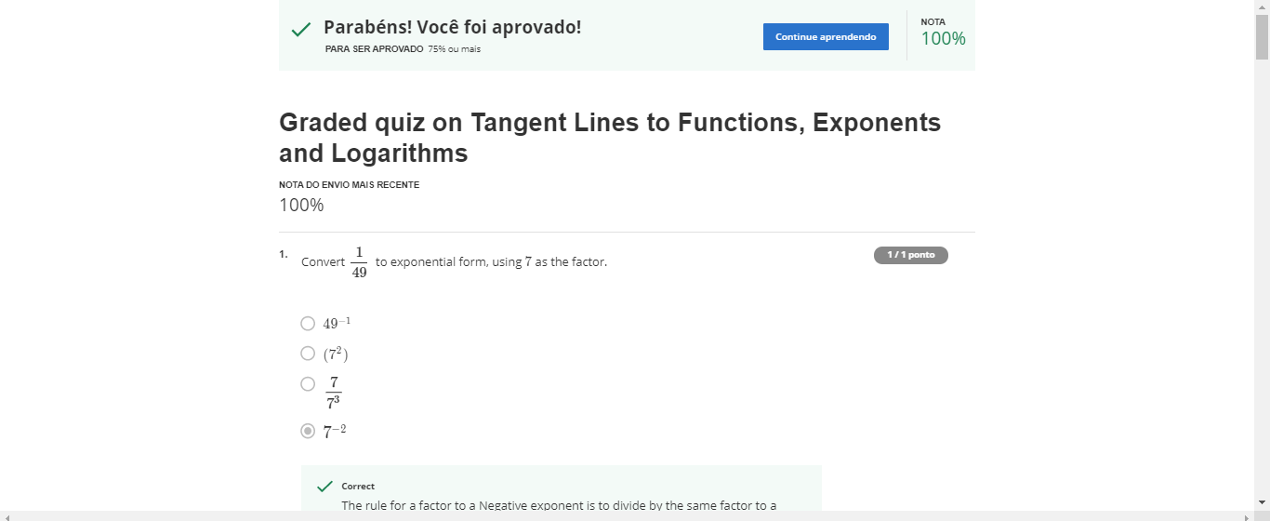
Graded Quizz on tangent lines to functions, log

Slide 48
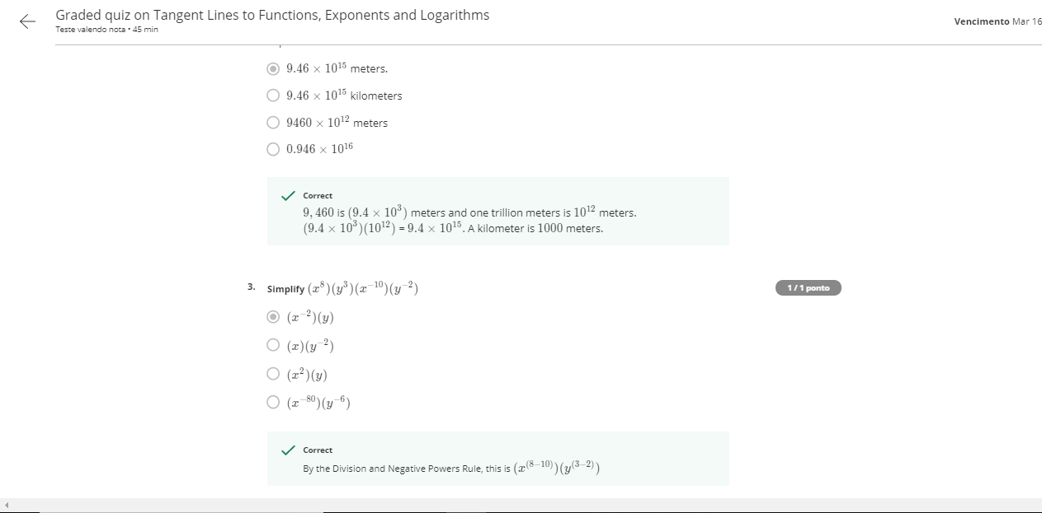
Graded Quizz on tangent lines to functions, log

Slide 49
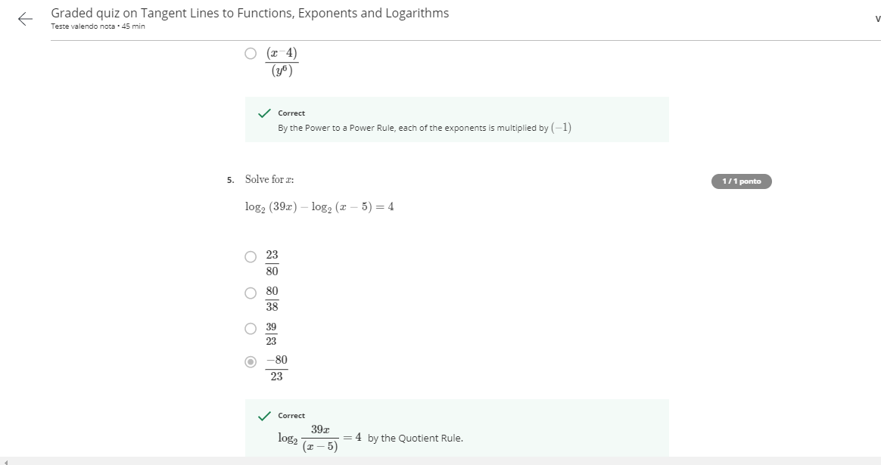
Graded Quizz on tangent lines to functions, log

Slide 50
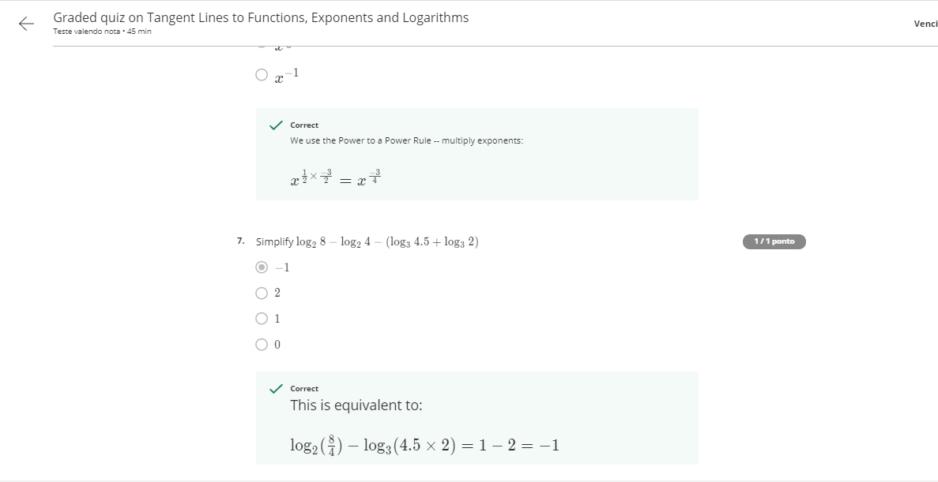
Graded Quizz on tangent lines to functions, log

Slide 51
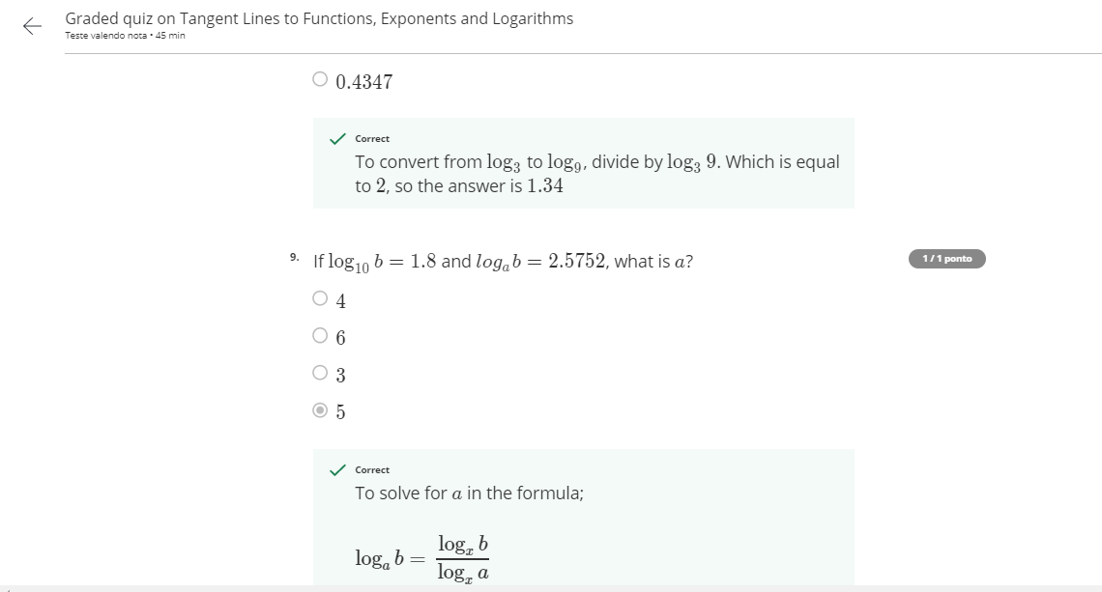
Graded Quizz on tangent lines to functions, log

Slide 52
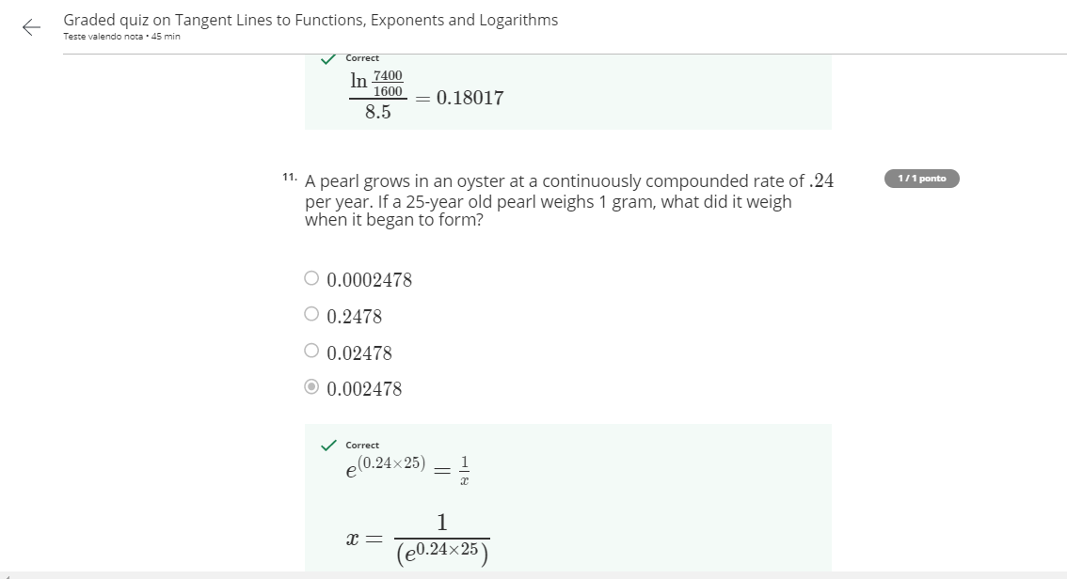
Graded Quizz on tangent lines to functions, log

Slide 53
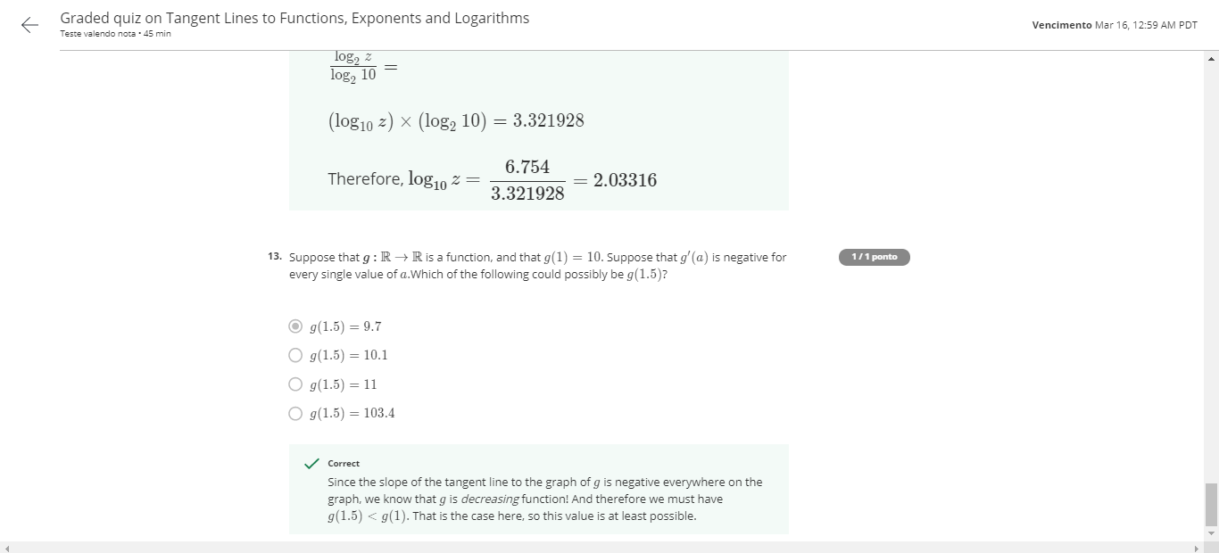
Graded Quizz on tangent lines to functions, log

Slide 54

Practice Quizz on prob concepts

Slide 55

Practice Quizz on prob concepts

Slide 56

Practice Quizz on prob concepts

Slide 57

Practice Quizz on prob concepts

Slide 58

Practice Quizz on prob concepts

Slide 59

Practice Quizz on prob concepts

Slide 60

Problem solving methods

Slide 61

Problem solving methods

Slide 62

Problem solving methods

Slide 63

Problem solving methods

Slide 64

Problem solving methods

Slide 65

Problem solving methods

Slide 66

Problem solving methods

Slide 67

Problem solving methods

Slide 68

Bayes Theorem

Slide 69

Bayes Theorem

Slide 70

Bayes Theorem

Slide 71

Bayes Theorem

Slide 72

Bayes Theorem

Slide 73

Bayes Theorem

Slide 74

Bayes Theorem

Slide 75

Graded quizz- Bayes Theorem

Slide 76

Graded quizz- Bayes Theorem

Slide 77

Graded quizz- Bayes Theorem

Slide 78

Graded quizz- Bayes Theorem

Slide 79

Graded quizz- Bayes Theorem

